Slide 1


Multi-Omics Data Analysis Program Using Simulation
2024 International Academic Exchange Conference
Computation, Data, and Society Lab MS Kim, Sangjin

Slide 2

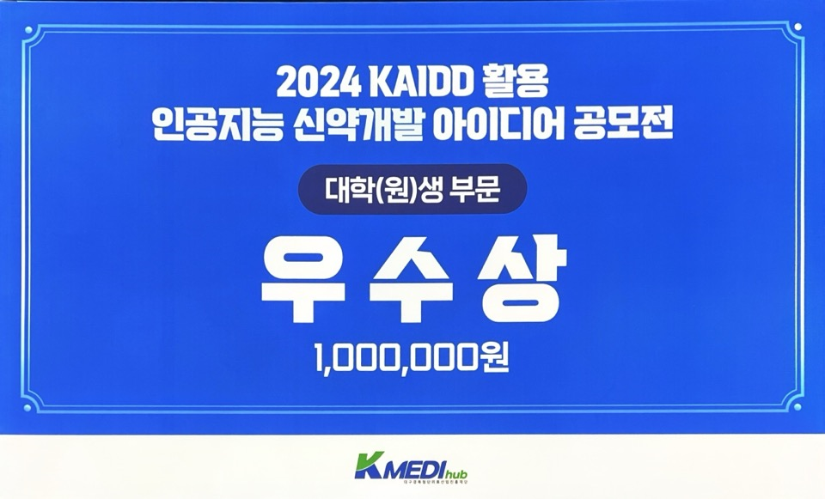

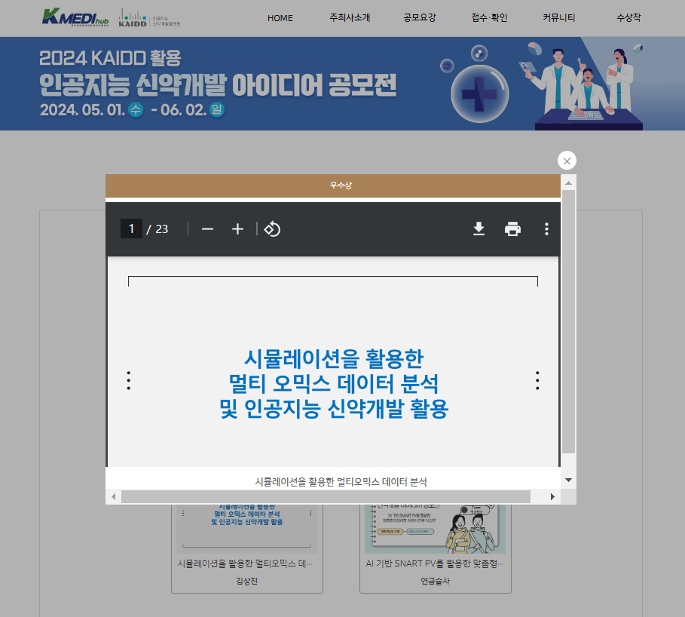


Slide 3
Analysis of Multi-Omics Data Using Simulation and Application of
AI Drug Discovery

Slide 4
Index
00
01
02
03
04
Omics data
Reason for proposal
Content of the proposal
Expected effect
References

Slide 5
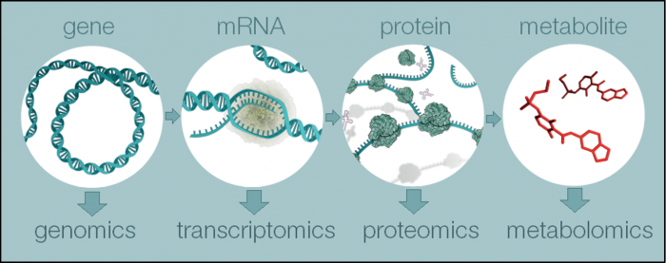
00
Omics data

Slide 6
00
Omics refers to the study of specific biological systems, such as genes, proteins, and metabolites. For example, genomics refers to the study and analysis of the genome related to genes.
Multi-omics helps to provide a more comprehensive understanding of biological systems by integrating various omics data.
The rationale behind this is that metabolites are generated from the genome. DNA is transcribed into mRNA, which is then translated into various proteins. These proteins participate in numerous chemical reactions to produce metabolites.

Slide 7




01
Limitation of Existing Methods
Results derived from individual omics data analysis
Tabular data format that makes it difficult to identify unknown associations
Black Box model with limited interpretability for explaining complex biological processes
4
Data collection and model selection costs

Slide 8


01
Transforming tabular omics data into image-like representation to identify unknown associations using CNNs.
Multi-Omics Data
Analysis Program Using Simulation
Save computation time and Improve analysis accuracy
by utilizing transfer learning.
Expected to achieve innovate results while overcoming
the limitations of traditional machine learning.
Cost reduction for data collection and model selection through data simulation.
4

Slide 9
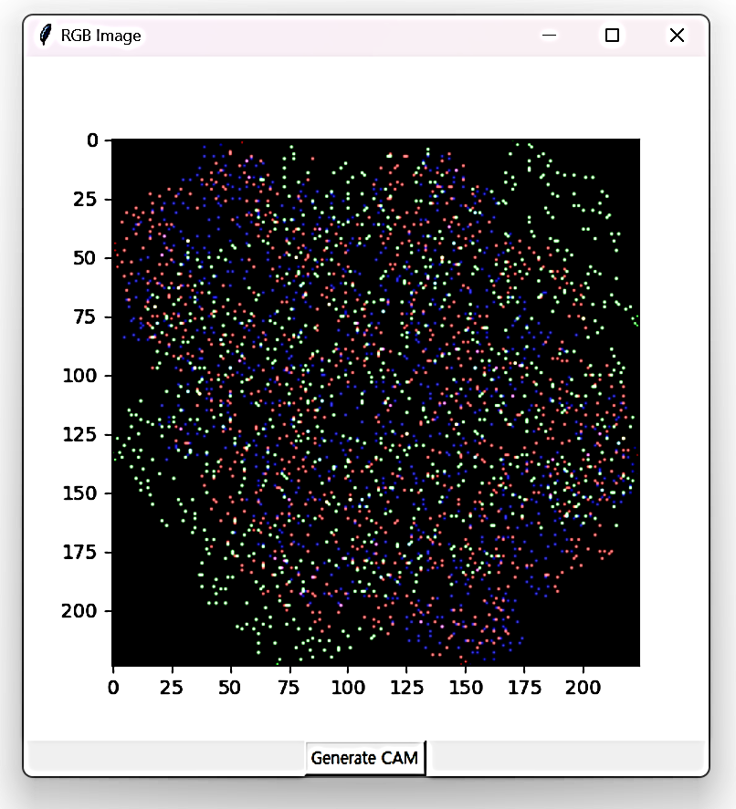
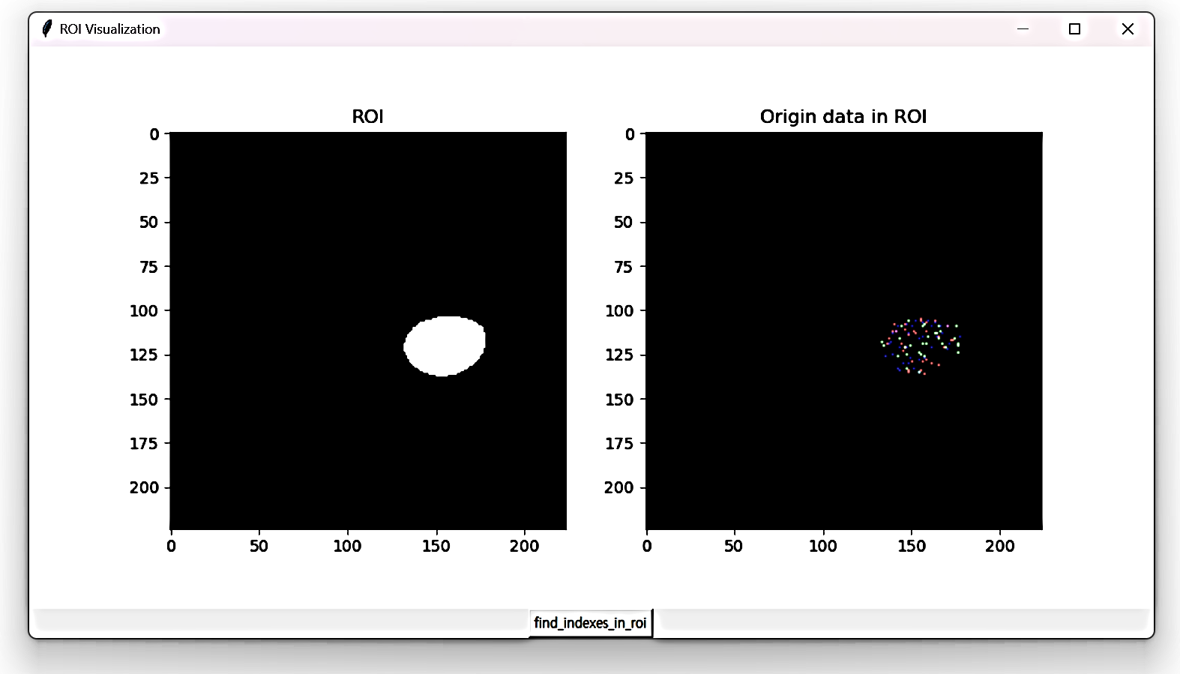
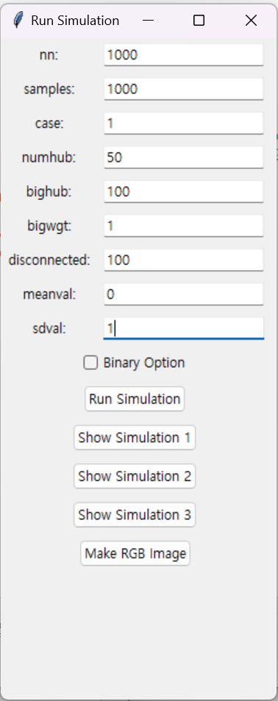
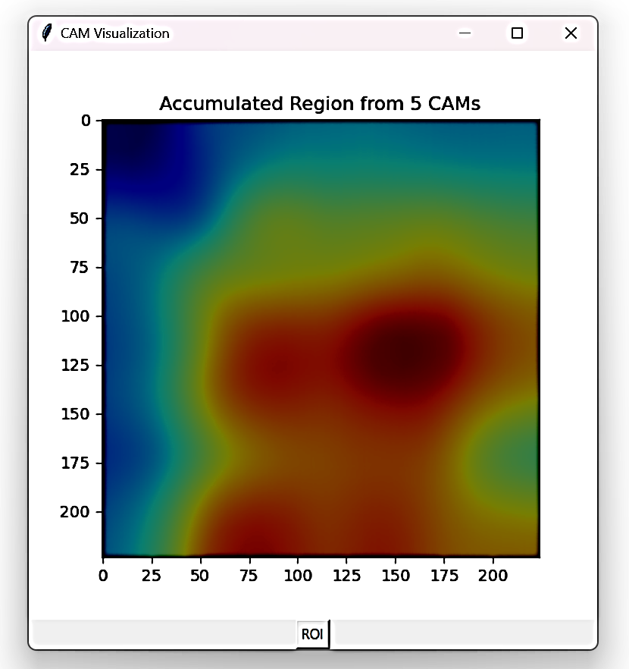
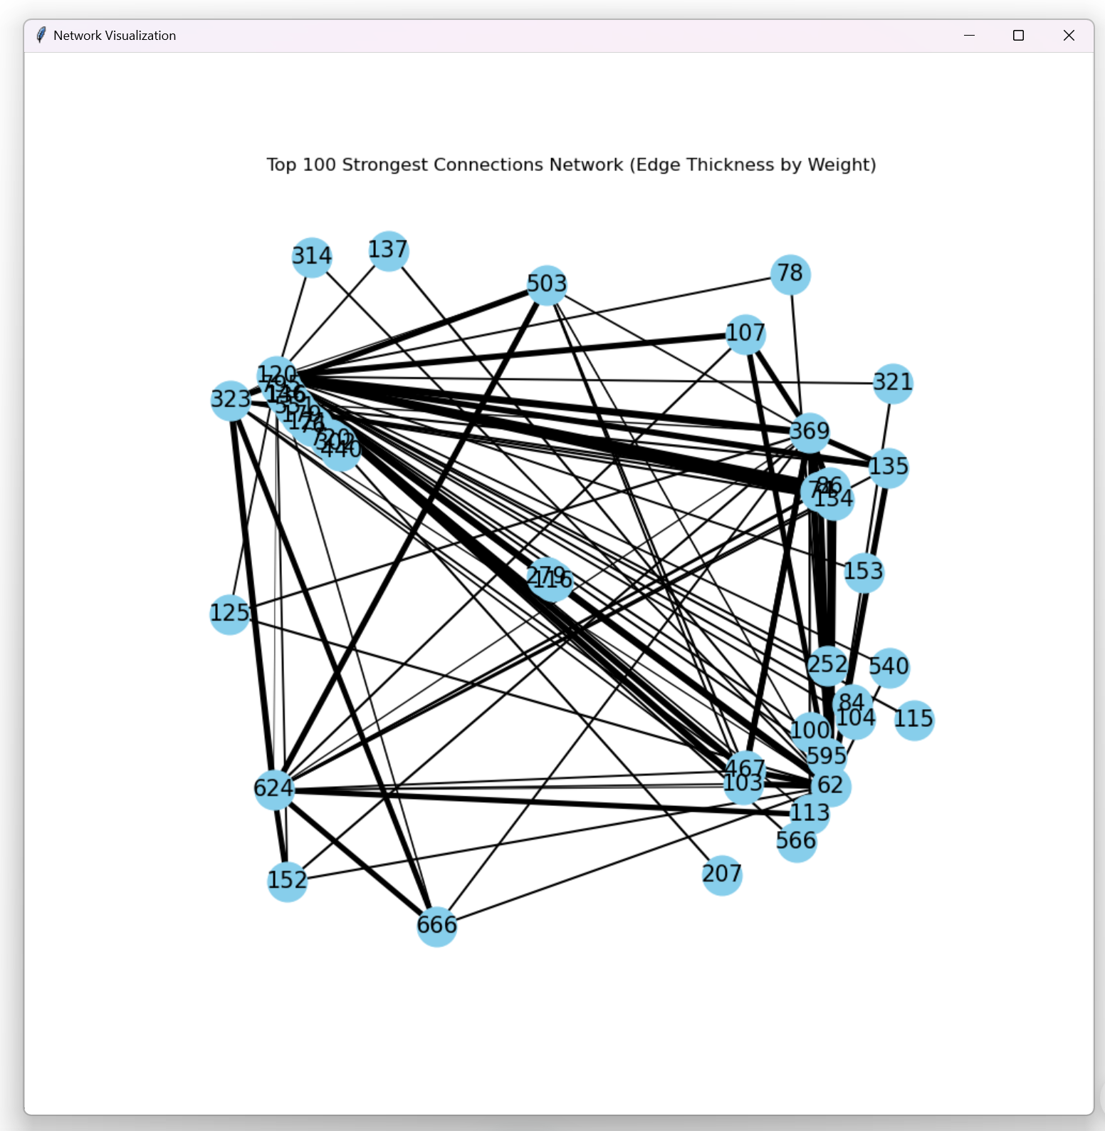
Multi-Omics Data Analysis Program Using Simulation
Transformation into image-like
Extraction variables of interest
Multi-Omics data simulation
Transfer Learning | ResNet50
Network Analysis

Slide 10
02
Data Simulation
Data assuming various distribution and scenarios
=> Improving model generation
Securing sufficient amount of data
=> Overcoming the limitation of actual data collection
Pre-testing model performance for specific scenarios
=> Making the model development process efficiently
[ Option window of data simulation ]

Slide 11
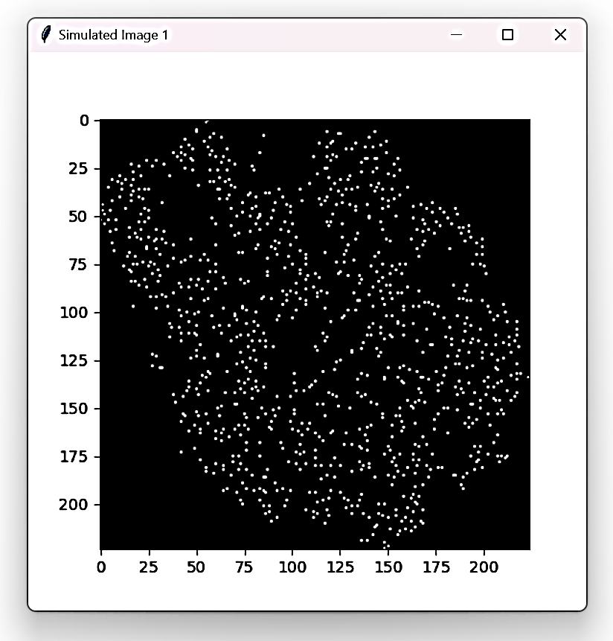
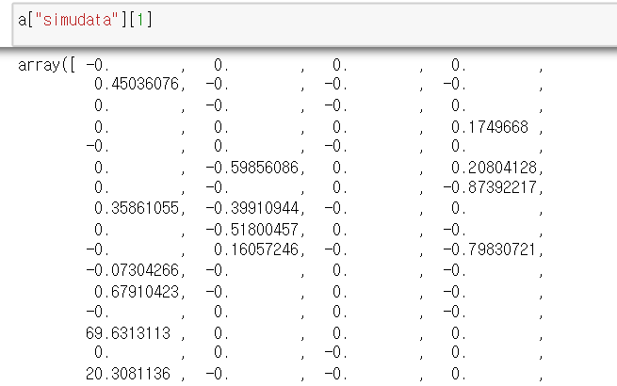
02
t-SNE
[ Table format data generated by simulation ]
[ Simulation data represented in images ]
By transforming tabular data, where most variables are represented independently, into image data, we can more effectively apply image analysis techniques to better understand the unknown associations between omics data

Slide 12
02
[ Simulation data represented in images ]
t-SNE (t-distributed Stochastic Neighbor Embedding) transforms high-dimensional data into a lower-dimensional space by placing similar data points close together while keeping dissimilar data points farther apart
t-SNE effectively groups similar data points, allowing CNN models to better interpret the complex structures and patterns of omics data

Slide 13
02
Omics data encompasses individual biological layers such as genomics, transcriptomics, proteomics, and metabolomics.
However, biological systems operate through complex interactions among these layers.
By integrating the omics data obtained through simulation into a single image and inputting it into a CNN model, we can capture the interactions among various omics data, thereby enhancing structural biological understanding and providing richer content for analysis.
[ Simulation data represented in images ]

Slide 14
02
Identifying numerous interactions and modeling nonlinear effects
provides effective regularization performance that can relieve the
risk of overfitting
Relationship inference of multi-omics data
using deep learning.
Accommodating information from various omics data.
Comprehensive analysis of data at various levels

Slide 15
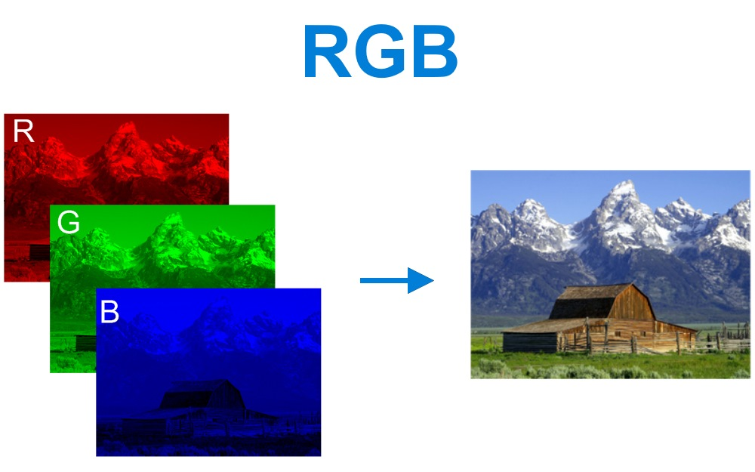
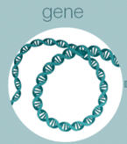
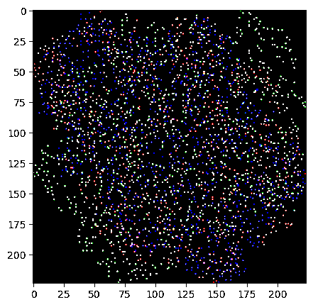
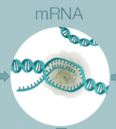
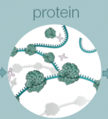
Color image data consist of red, green, and blue (RGB) channels. In this program, each omics data is treated as a single color channel to create a multi-omics image data.

Slide 16
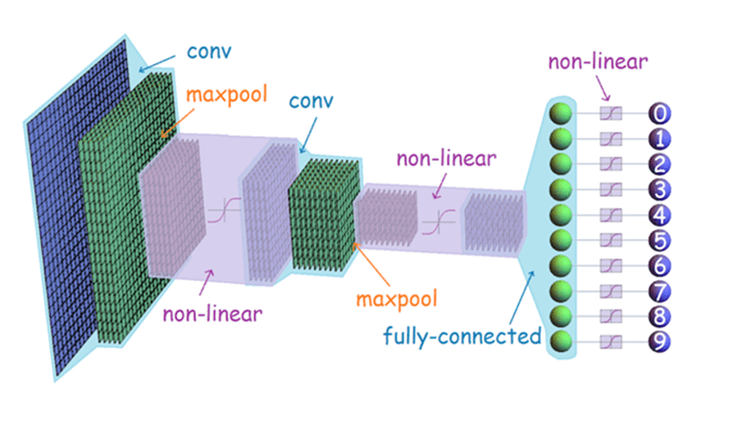
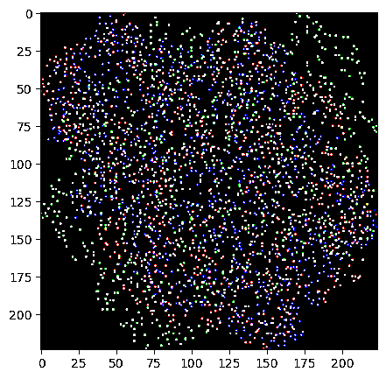
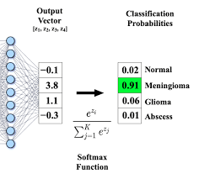
CNN consists of two main parts:
a) Extracting features from images
The feature extraction part is made up of Convolution Layers. Convolution layers apply filters to the input image to generate feature maps. The optional Pooling layer extracts significant values such as the average and maximum from the feature maps.
Subsequently, an activation function is applied to the feature maps obtained from the convolution or pooling layers to add non-linearity.

Slide 17
b) Classification and prediction based on the extracted features
The output obtained from the convolutional layer can be plugged into another convolutional layer, or it can be flattened into a vector for prediction or classification. All values in this vector should be fully connected to each class to ensure they are considered in making the decision. In this program, the softmax function was used for the final classification, which outputs the 'probabilities' for each class.

Slide 18
02
Transfer Learning
Building deep learning models requires vast resources.
Transfer learning allows for the reuse of knowledge from large datasets, enabling performance improvements even with smaller datasets.
By fine-tuning pre-trained models for new tasks, it reduces the need for data collection while enhancing performance.

Slide 19
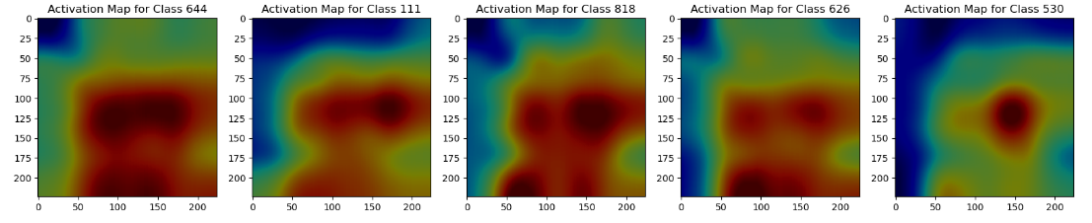
02
Class Activation Map
[ Highlighting regions within the image that influence predictions for each class ]
Class Activation Maps (CAM) highlight specific areas of an image that significantly influence the model's predictions for each class (e.g., the presence of disease, treatment response).
This helps identify important biological layers or variables, aiding in the interpretation of the model's prediction process, which can improve model performance and enhance its reliability.

Slide 20
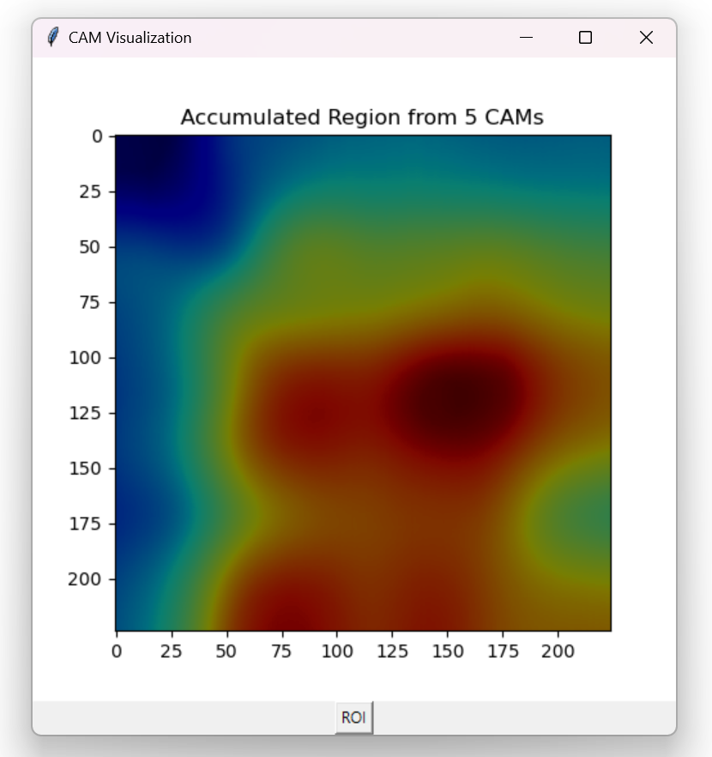
02
Class Activation Map
[ Highlighting areas that commonly influence all classes ]
By examining the average CAM, which highlights areas of multi-omics data that are commonly activated across all classes, we can gain a comprehensive understanding of complex biological interactions.
Analyzing class-specific CAM results alongside the average CAM, in relation to the original multi-omics data, allows for a deeper understanding of biological mechanisms related to the occurrences of a disease and treatment responses.

Slide 21
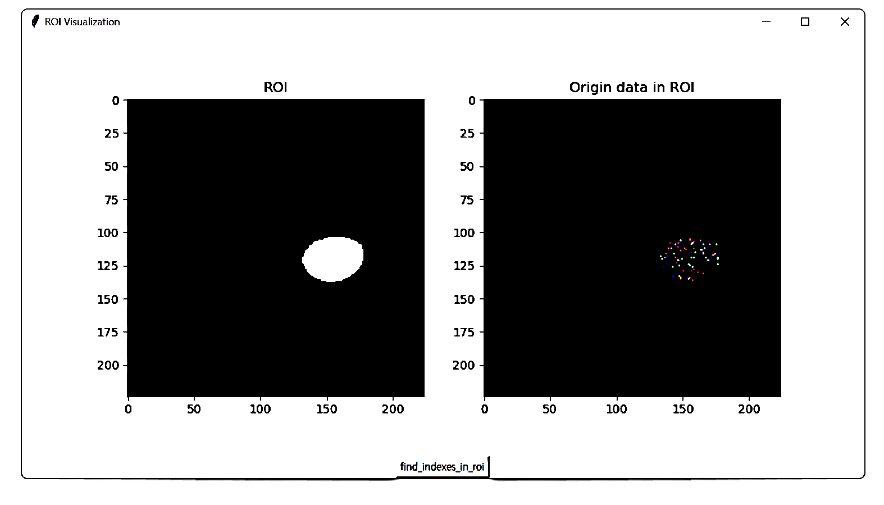
02
Mapping the original data to the ROI
[ ROI obtained from the image using CAM ]
[ Original multi-omics data located within the ROI ]

Slide 22
02
Mapping the original data to the ROI
[ ROI obtained from the image using CAM ]
[ Original multi-omics data located within the ROI ]
Using CAM (Class Activation Mapping), we can map the regions of interest that the deep learning model focuses on within the original multi-omics data. This allows us to extract the original data corresponding to these regions of interest.

Slide 23
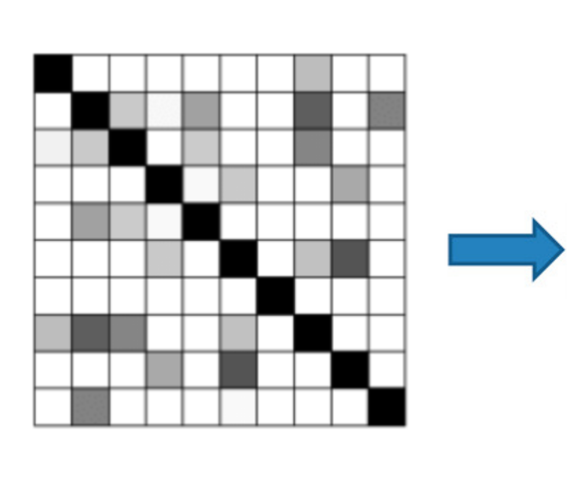
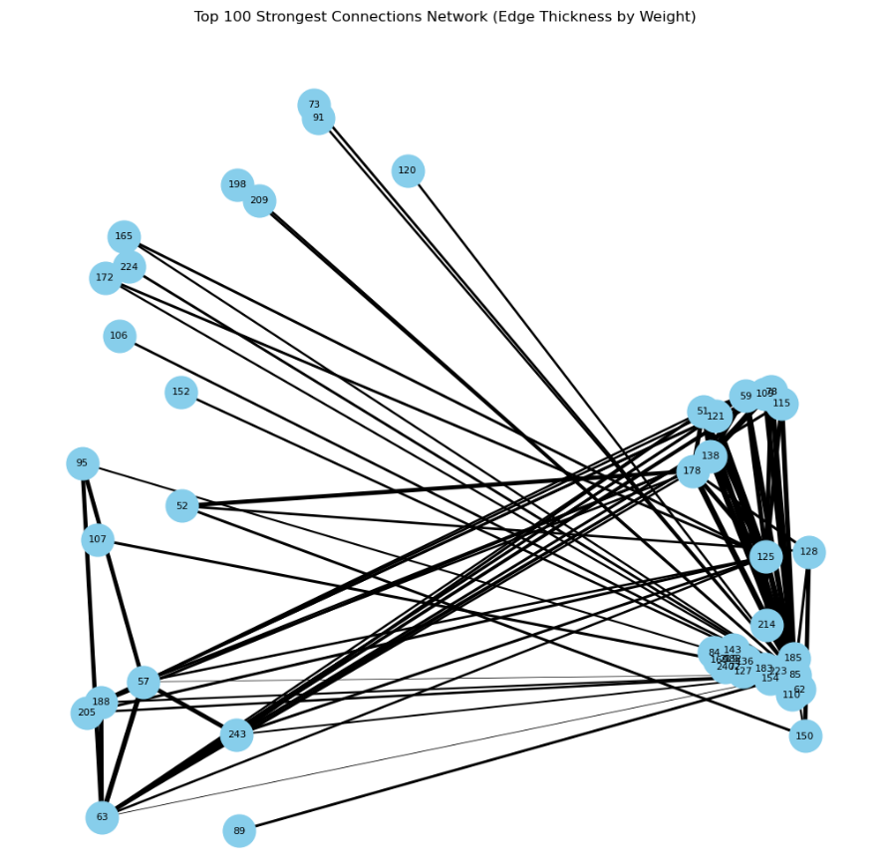
02
Deriving insights through network analysis
[ Covariance matrix of the variables in the ROI ]
[ Key networks among the variables in the ROI ]
Based on the covariance matrix that shows the relationships between the variables of the extracted original data, we can model a network.

Slide 24
02
Deriving insights through network analysis
By analyzing the correlations among variables in the region of interest and the network structure, we can understand
the interactions between variables within biological systems.
This allows for a more detailed explanation of complex biological processes such as the occurrence of a disease and treatment responses.
As a result, network analysis contributes to enhancing the biological interpretability of models utilizing deep learning.
[ Key networks among the variables in the ROI ]

Slide 25
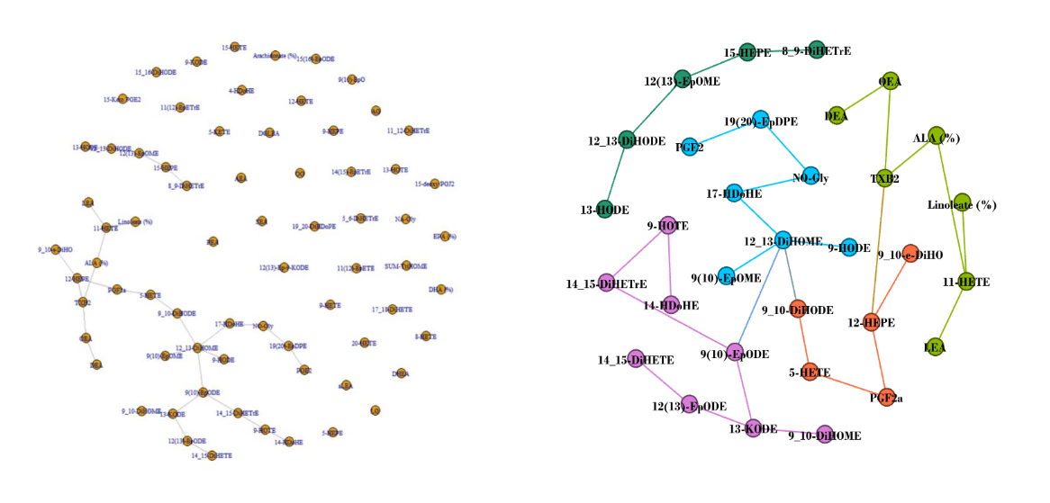
02
Deriving insights through network analysis
[ Identifying key relationships within the network ]
[ Clustering within key relationships ]

Slide 26
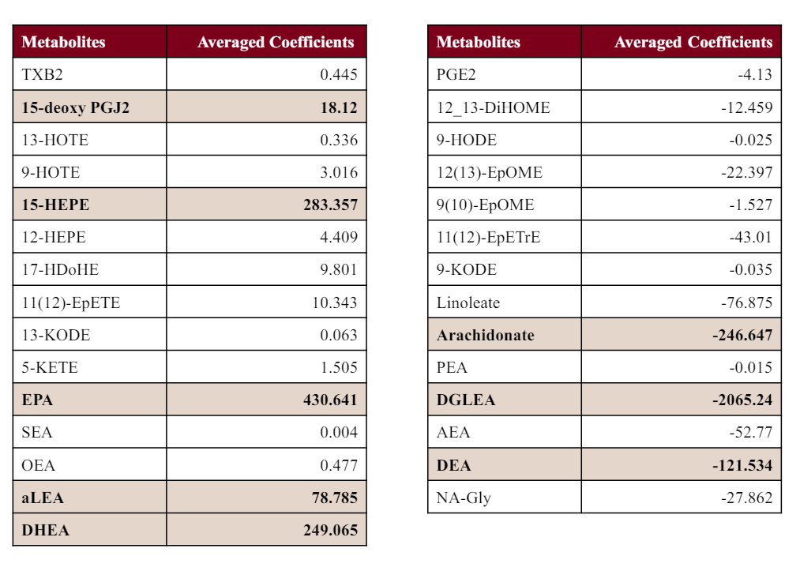
02
Deriving insights through network analysis
[The variables that have a positive and negative relationship with the possibility of occurrence]

Slide 27

03
Limitation of Existing Methods
Tabular data format that makes it difficult to identify potential relationships
Results derived from individual omics data analysis
Black Box model with limited interpretability for explaining complex natural processes
4
Data collection and model selection costs

Slide 28


03
Enhancement of understanding biological systems
Optimization of biological systems
Integratively analyzing various omics data, such as genomics, transcriptomics, proteomics, and metabolomics, to understand the complex interactions within biological systems.
Using simulations to test and validate hypotheses that are difficult to experimentally verify.
Platforms like Motif Dr and WPLite can assist in understanding the structure and function of specific genes or proteins before drug development
By adjusting specific parameters of biological systems through simulations, we can provide a customized experience for users.
Assumptions and experiments for various scenarios can be applied to gene manipulation, metabolic pathway design, and drug development.

Slide 29
03
Personalized medicine and healthcare
The role of educational programs
Analysis and simulation of individual omics data can be utilized for disease prevention, treatment, and management.
By considering an individual's genetic traits and lifestyle, it can help tailor the results from various platforms to better suit personal needs.
Additionally, it can assist in more precisely identifying drug candidates through platforms like AD3 and AI Drug.
It can be utilized as a tool to visualize and understand complex biological systems in medical education.
In the field of medical research, it can aid in hypothesis testing, experimental design, and data analysis.
Because it offers easy operation methods and experiences based on various scenarios, it is expected to play a significant role in new educational programs within KAIDD.

Slide 30
04
Alok Sharma, Artem Lysenko, Shangru Jia, Keith A. Boroevich & Tatsuhiko Tsunod, Advances in AI and machine learning for predictive medicine, Journal of Human Genetics, 2024
Alok Sharma, Edwin Vans, Daichi Shigemizu, Keith A. Boroevich & Tatsuhiko Tsunoda, DeepInsight: A methodology to transform a non-image data to an image for convolution neural network architecture, Scientific Reports , 2019
Anastasia Zompola, Aigli Korfiati, Konstantinos Theofilatos, and Seferina Mavroudid,Omics-CNN: A comprehensive pipeline for predictive analytics in quantitative omics using one-dimensional convolutional neural networks, Heliyon, 2023

Slide 31


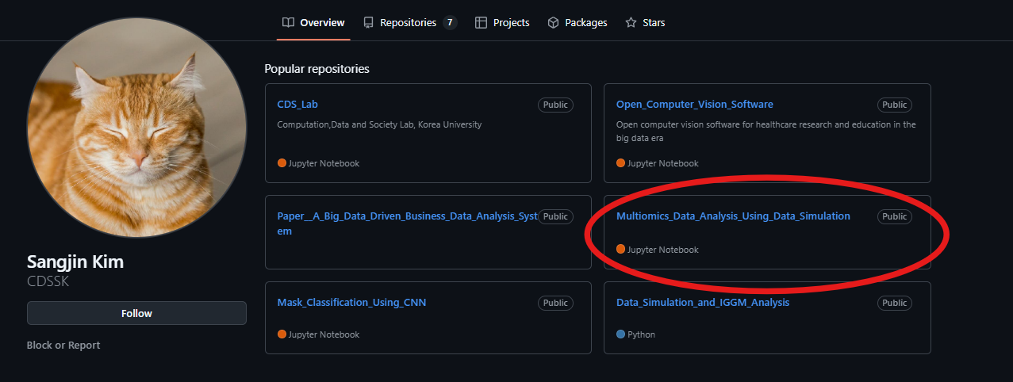
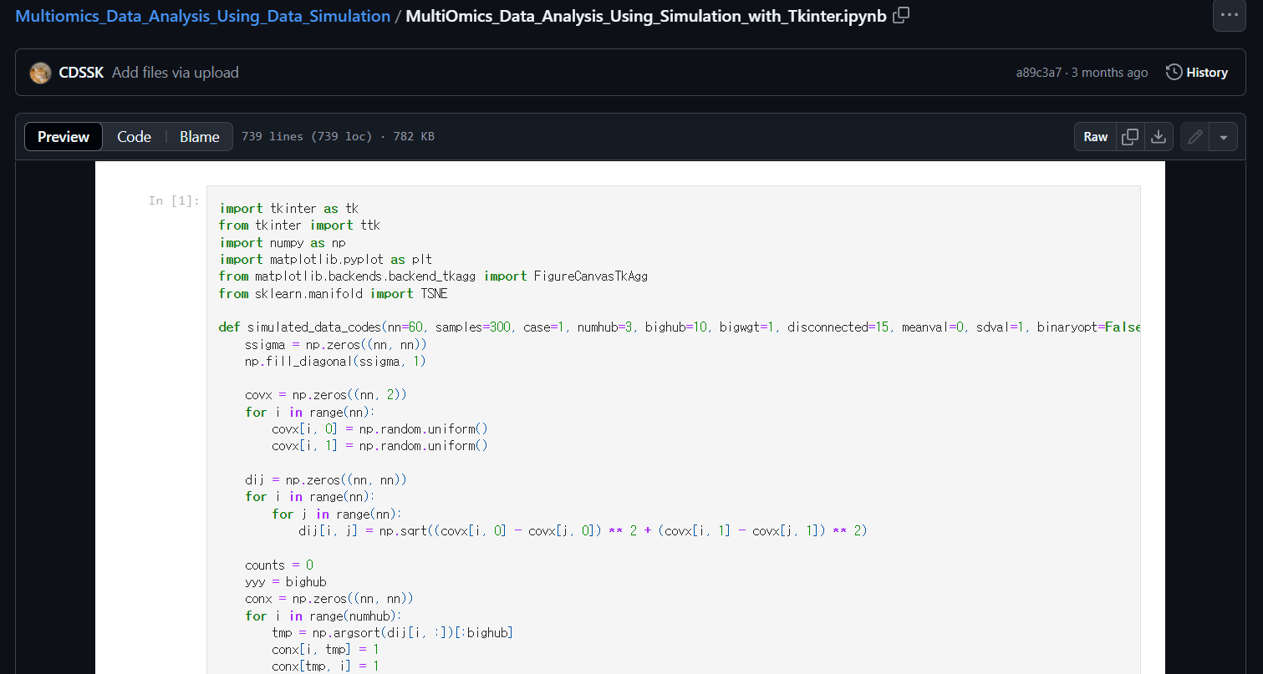

Slide 32
Thank You!
Multi-Omics Data Analysis Program Using Simulation
2024 International Academic Exchange Conference
Computation, Data, and Society Lab MS Kim, Sangjin

